Slide 1
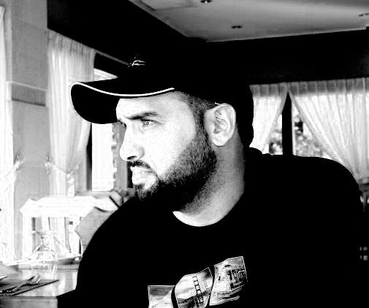
How Browsers Work:
Abdulkarim Albanna
www.abedelkarim.com
www.facebook.com/abdulkarimAlbanna

Slide 2
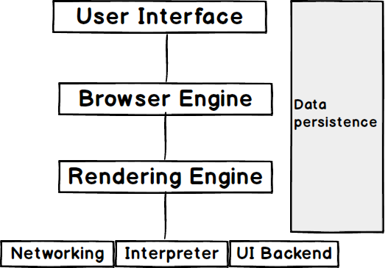
Brower Components

Slide 3
Render Main Flow
Loading the resources
Parsing the HTML
Create render tree
Layout the render tree
Painting

Slide 4
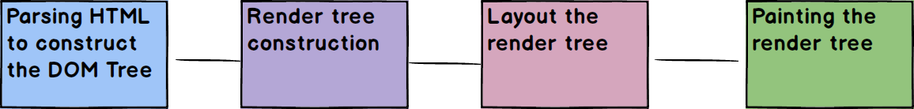
Render Main Flow

Slide 5
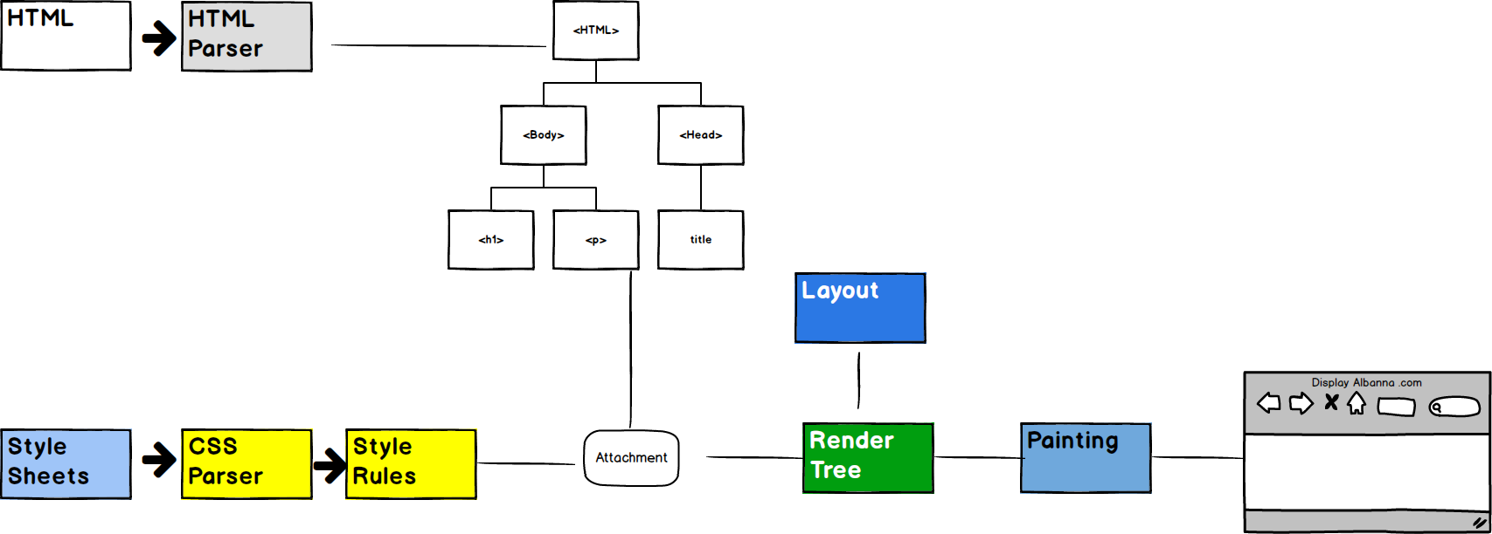
Render Main Flow

Slide 6
Next Session

